Slide 1
Choosing the right Statistical Test

Slide 2
Outline
What does a statistical test do?
When to perform a statistical test?
Choosing a parametric test
Regression
Comparison
Correlation
Choosing a non-parametric test

Slide 3
Introduction
Statistical tests are used in hypothesis testing.
They can be used to:
Determine whether a predictor variable has a statistically significant relationship with an outcome variable.
Estimate the difference between two or more groups.

Slide 4
Introduction
Statistical tests assume a null hypothesis of no relationship or no difference between groups. Then they determine whether the observed data fall outside of the range of values predicted by the null hypothesis.

Slide 5
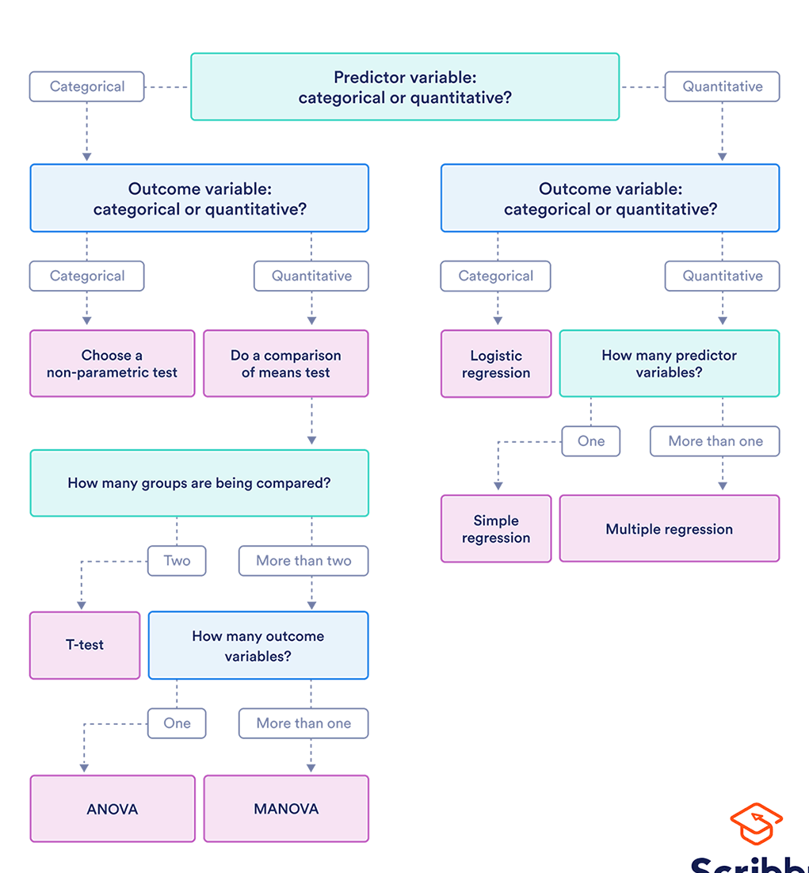
Introduction
If you already know what types of variables you’re dealing with, you can use the flowchart to choose the right statistical test for your data.

Slide 16
What does a statistical test do?
Statistical tests work by calculating a test statistic – a number that describes how much the relationship between variables in your test differs from the null hypothesis of no relationship.

Slide 17
What does a statistical test do?
It then calculates a p value (probability value).
The p-value estimates how likely it is that you would see the difference described by the test statistic if the null hypothesis of no relationship were true.

Slide 18
What does a statistical test do?
If the value of the test statistic is more extreme than the statistic calculated from the null hypothesis, then you can infer a statistically significant relationship between the predictor and outcome variables.

Slide 19
What does a statistical test do?
If the value of the test statistic is less extreme than the one calculated from the null hypothesis, then you can infer no statistically significant relationship between the predictor and outcome variables.

Slide 20
When to perform a statistical test?
You can perform statistical tests on data that have been collected in a statistically valid manner – either through an experiment, or through observations made using probability sampling methods.
For a statistical test to be valid, your sample size needs to be large enough to approximate the true distribution of the population being studied.

Slide 21
When to perform a statistical test?
To determine which statistical test to use, you need to know:
whether your data meets certain assumptions.
the types of variables that you’re dealing with.

Slide 22
Statistical Assumptions
Independence of observations (a.k.a. no autocorrelation): The observations/variables you include in your test are not related (for example, multiple measurements of a single test subject are not independent, while measurements of multiple different test subjects are independent).
Homogeneity of variance: the variance within each group being compared is similar among all groups. If one group has much more variation than others, it will limit the test’s effectiveness.
Normality of data: the data follows a normal distribution (a.k.a. a bell curve). This assumption applies only to quantitative data.

Slide 23
Statistical Assumptions
If your data do not meet the assumptions of normality or homogeneity of variance, you may be able to perform a nonparametric statistical test, which allows you to make comparisons without any assumptions about the data distribution.
If your data do not meet the assumption of independence of observations, you may be able to use a test that accounts for structure in your data (repeated-measures tests or tests that include blocking variables).

Slide 24
Types of variables
The types of variables you have usually determine what type of statistical test you can use

Slide 25
Types of variables
Quantitative variables represent amounts of things. Types of quantitative variables include:
Continuous (aka ratio variables): represent measures and can usually be divided into units smaller than one (e.g. 0.75 grams).
Discrete (aka integer variables): represent counts and usually can’t be divided into units smaller than one (e.g. 1 tree).
Categorical variables represent groupings of things. Types of categorical variables include:
Ordinal: represent data with an order (e.g. rankings).
Nominal: represent group names (e.g. brands or species names).
Binary: represent data with a yes/no or 1/0 outcome (e.g. win or lose).

Slide 26
Types of variables
Choose the test that fits the types of predictor and outcome variables you have collected (if you are doing an experiment, these are the independent and dependent variables).
Consult the tables below to see which test best matches your variables.

Slide 27
Choosing a parametric test: regression, comparison, or correlation
Parametric tests usually have stricter requirements than nonparametric tests, and are able to make stronger inferences from the data. They can only be conducted with data that adheres to the common assumptions of statistical tests.
The most common types of parametric test include regression tests, comparison tests, and correlation tests.

Slide 28
Regression tests
Regression tests look for cause-and-effect relationships. They can be used to estimate the effect of one or more continuous variables on another variable.

Slide 29
Regression tests
 | Predictor variable | Outcome variable | Research question example
Simple linear regression | Continuous One predictor | Continuous One outcome | What is the effect of income on longevity?
Multiple linear regression | Continuous One or more predictors | Continuous One outcome | What is the effect of income and minutes of exercise per day on longevity?
Logistic regression | Continuous | Binary | What is the effect of drug dosage on the survival of a test subject?

Slide 30
Comparison Tests
Comparison tests look for differences among group means. They can be used to test the effect of a categorical variable on the mean value of some other characteristic.
T-tests are used when comparing the means of precisely two groups (e.g., the average heights of men and women). ANOVA and MANOVA tests are used when comparing the means of more than two groups (e.g., the average heights of children, teenagers, and adults).

Slide 31
Comparison Tests
 | Predictor variable | Outcome variable | Research question example
Paired t-test | Categorical 1 predictor | Quantitative Groups come from the same population | What is the effect of two different test prep programs on the average exam scores for students from the same class?
Independent t-test | Categorical 1 predictor | Quantitative groups come from different populations | What is the difference in average exam scores for students from two different schools?
ANOVA | Categorical 1 or more predictor | Quantitative 1 outcome | What is the difference in average pain levels among post-surgical patients given three different painkillers?
MANOVA | Categorical 1 or more predictor | Quantitative 2 or more outcome | What is the effect of flower species on petal length, petal width, and stem length?

Slide 32
Correlation tests
Correlation tests check whether variables are related without hypothesizing a cause-and-effect relationship.
These can be used to test whether two variables you want to use in (for example) a multiple regression test are autocorrelated.
 |  | Research question example
Pearson’s r | 2 continuous variables | How are latitude and temperature related?

Slide 33
Choosing a nonparametric test
Non-parametric tests don’t make as many assumptions about the data, and are useful when one or more of the common statistical assumptions are violated.
However, the inferences they make aren’t as strong as with parametric tests.

Slide 34
 | Predictor variable | Outcome variable | Use in place of…
Spearman’s r | Quantitative | Quantitative | Pearson’s r
Chi square test of independence | Categorical | Categorical | Pearson’s r
Sign test | Categorical | Quantitative | One-sample t-test
Kruskal–Wallis H | Categorical Two or more groups | Quantitative | ANOVA
ANOSIM | Categorical Two or more groups | Quantitative 2 or more outcome variables | MANOVA
Wilcoxon Rank-Sum test | Categorical Two groups | Quantitative Groups come from different populations | Independent t-test
Wilcoxon Signed-rank test | Categorical Two groups | Quantitative Groups come from the same population | Paired t-test

Slide 35
References
https://www.scribbr.com/statistics/statistical-tests/

